Slide 1
WELCOME
Home Education Partnership of Texas, Inc.

Slide 2
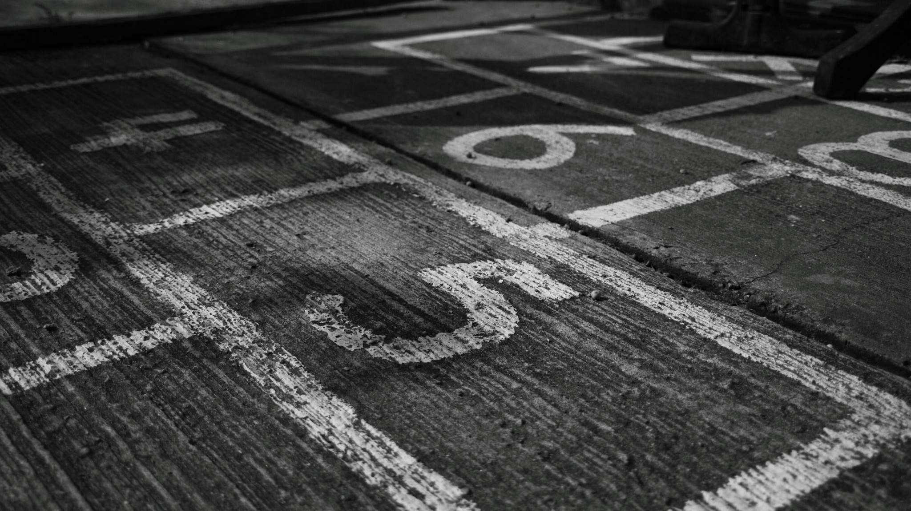
Founded in 1997 Joanne E. Juren - owner

Slide 3
Our Mission
The Home Education Partnership of Texas exists to enhance and strengthen home education opportunities in Texas by:
Providing educational courses and curriculum, and opportunities for recognition, recreation and achievement to homeschooling students and families;
Facilitating communication and collaboration among participants and supporters in the home education community;
Linking homeschooling students and families with appropriate educational resources;
Advocating on behalf of home education to the general public, media, and educational and governmental agencies.

Slide 4
University Model Program
HEP TX offers classes for PreK 3 – 12th grade.
HEP TX offers academic and elective classes.
HEP TX offers honors courses and regular classes.
Students may attend 1 class or many.
We offer a payment plan.

Slide 5
Honors Classes
HEP Tx offers a wide choice of honors classes in science, mathematics, language arts, social sciences, and speech.
58 former students have earned a PhD.
Eta Sigma Alpha National Home School Honor society
National Home School Science Honor Society

Slide 6
TeacherEase
On-line grading program
Provides a transcript of all classes and grades.
24/7 service and connection to the school/teachers
Send Announcements
Email teachers

Slide 7
Policies/Rules Please read and review with your student.

Slide 8
Activities and Clubs
We offer a variety of academic and fun activities.

Slide 9
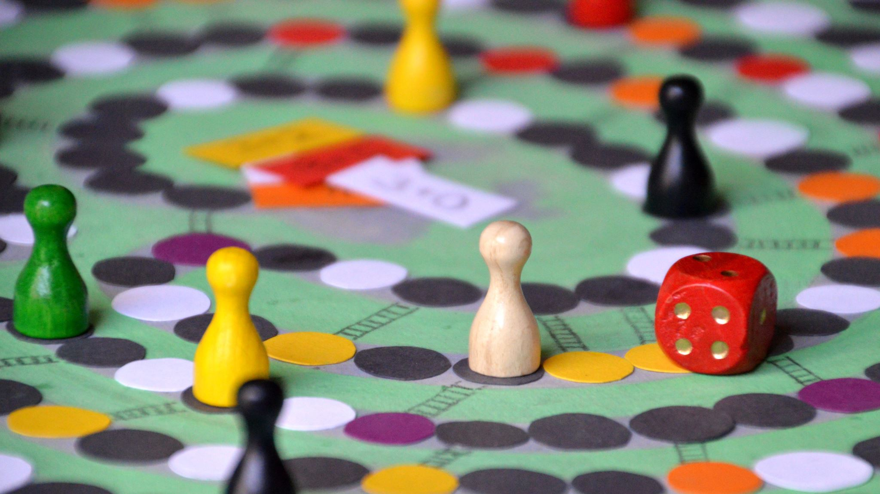
Clubs
Chess Club – meets the third Thursday at 3:30 pm

Slide 10
Yearbook Club Journalism Class
Podcast, newspaper, and yearbook production groups.

Slide 11
Eta Sigma Alpha National Home School Honor Society
HEP TX hosts the Alpha Chapter founded in 1997.

Slide 12
Dances, movie nights, field trips, parties, and lots more fun help make HEP students make friends.
“HEP TX is like a family!”

Slide 13
Homecoming 2023
Homecoming Dance
Homecoming Court

Slide 14
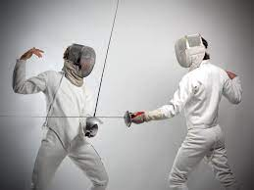
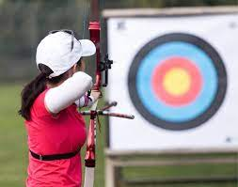
Sports
Archery and Fencing

Slide 15
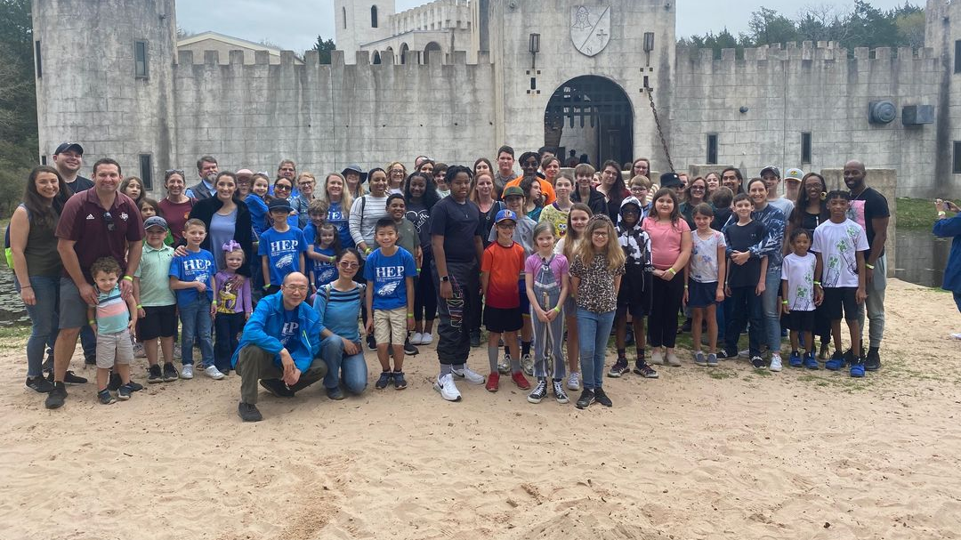
Newman’s Castle Field Trip
February 2023

Slide 16
Outstanding Student Awards Day Program
Spring Semester

Slide 17
Senior Events
Prom and Graduation
Hope Lutheran – May 13

Slide 18
57 Classes Middle School and High School
Teachers have degrees.
Teachers are employees of HEP TX, Inc.
Joanne E. Juren, B.A., M.Ed. – Principal
heptx.com

Slide 19
Journey Through Time - Award Winning Honors Humanity program….
Nobel Family – Home School Innovative Use of Curriculum Grant “Flip-It Methdology”
Cathy Duffy: “First true honors curriculum for homeschoolers.”

Slide 20
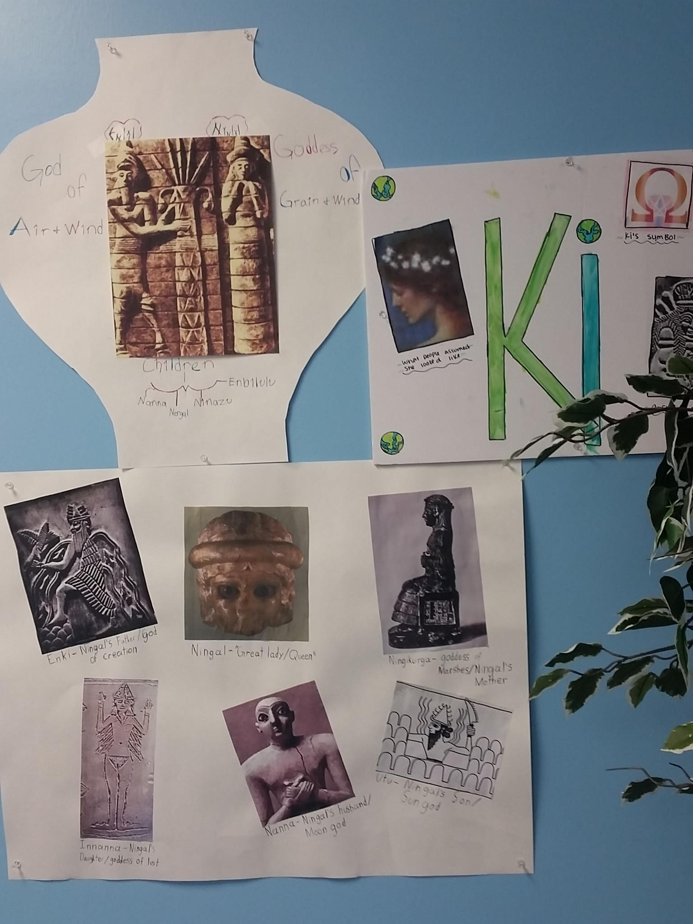
Grade 8 - 2 high school credits English 8 Middle School History Old Testament (1) Art (1/2) Drama (1/2)
Grade 8 – Ancient Times (Sue Rothberg)

Slide 21
Grade 9 - 4 high school credits English 9 (1) Ancient History (1) New Testament (1/2) Philosophy (1/2) Art (1/2) Drama (1/2)
The Greeks and Romans, and the Rise of Christianity –
Joanne Juren

Slide 22
Grade 10 - 4 high school credits English 10 (1) World History (1) Art History (1/2) Philosophy (1/2) Rhetoric (1/2) Drama (1/2)
Medieval Times – Sue Rothberg

Slide 23
Grade 11 - 4 high school credits English 11 (1) American History (1) Philosophy (1/2) Art History (1/2) Rhetoric (1/2) Drama (1/2)
The Renaissance & Reformation
The Age of Reason & The Enlightenment – Joanne Juren

Slide 24
Grade 12 - 4 credits English 12 -1 Modern History -1 Philosophy (1/2) Art History (1/2) Rhetoric (1/2) Drama (1/2)
Modern to Postmodern Times – Joanne Juren

Slide 25
Math/Science Many of our former students earn engineering, medical, and other science/math related degrees.
Saxon 7/6 – Calculus
Science 6 - Physics

Slide 26
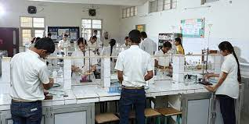
HEP TX has 2 fully equipped science labs.
Students experience hands-on activities in all science classes from PreK – 12th grade.
Life sciences, chemistry, physics, engineering, and technology provide students with great opportunities to explore future careers.

Slide 27
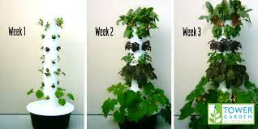
Tower Garden – new in 2023
Botony, Biology, and Classical School students will learn to grow food on a Tower Garden!

Slide 28
STEM
HEP offers STEM classes for grades 3-12.
We offer a STEAM Camp in the summer for grades K-12.

Slide 29
Electives
Art, Music, Psychology, Logic, Speech, Sewing/Quilting, Culinary, and many more

Slide 30
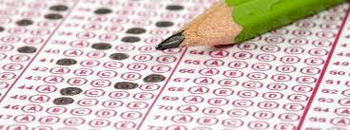
IOWA Testing
May 16 and 17
All homeschoolers are welcome to test with HEP Tx.

Slide 31
Camps and Academic Classes are offered in the summer.
Speech, Logic, Writing, Sports, Music, and more…..

Slide 32
SAT Math Hack Camp coming this summer!
Need help scoring high on the math section of the SAT, then this camp is for you! Learning these 25 math hacks will help you to score 700 on the SAT Math.

Slide 33
Classes for 2023-24
View the schedule online at heptx.com.
Print a paper copy from the webpage at heptx.com.

Slide 34
Time | Monday | Tuesday | Wednesday | Thursday | Fridays/Sat.
9:00-10:30 am | JTT 8* JTT 9* English 9 Chem 1 English 8 | Science 6 Algebra 2* HS Spanish 1* English 7 | JTT 8* JTT 9* MS Spanish 1 Chem 1 MS Art Advanced PreK | Govt/Eco Algebra 2* HS Spanish 1* | Aviation (Fri) Guitar (Fri/Sat) MS Sign Language (Fri) Sewing/Quilting (Fri)
10:45-12:15 pm | Biology 1* Physical Science* World History English 12 HS Sign Language* | Science 7 English 6 Advanced Math* HS Spanish 2* | Biology 1* Physical Science* MS Spanish 2 MS Art Foundations PreK HS Sign Language* JTT 12 (10:45-1:45) | Advanced Math* HS Spanish 2* | Aviation (Fri) Archery (Fri) Guitar (Fri/Sat)
1:00-2:30 pm | JTT 11 JTT 10 Algebra 1 English 10 World Geography | Classical History Physics (12:15-2:30) Marine Bio | Culinary Arts MS Speech HS Art 1-4 Geometry Saxon 7/6 PreK JTT 12 (10:45-1:45) | Calculus HS Speech/Logic | Fencing (Fri) Consumer Math (Fri) Guitar (Fri/Sat)
2:45-4:15 pm | JTT 11 JTT 10 English 11 Bio 2 | Saxon 8/7 Saxon Alg ½ Psychology Algebra 1 (3:30-5) Violin (Tues 5-7 pm) | MS Stem Journalism Bio 2 | HS Stem Calculus Violin (Thurs 5-7 pm) | Guitar (Fri/Sat) Violin (Sat)

Slide 35
Our Motto
Scientia Libertate, Mundous Domo
“Knowledge Through Freedom, The World Through Home”

